Slide 1

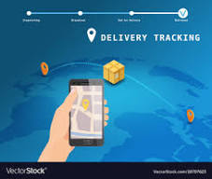

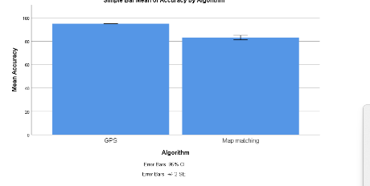
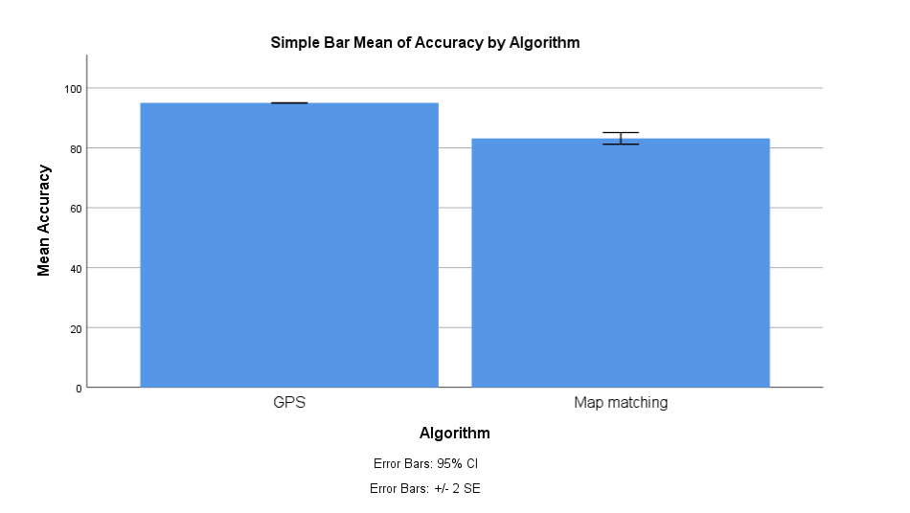
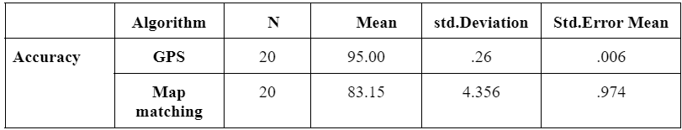
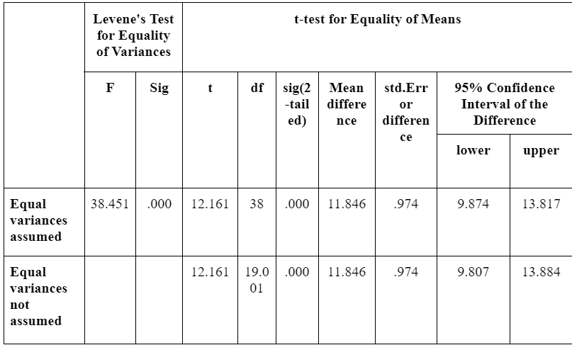
Name: Mr. Tathireddy Teja Register Number: 192110191
Guided by Dr. D.Manikevalan
Ms. Poorani.S
Guided by Dr. Mary Valantina. G
Strengthen the shipment management tracking system that utilizes mobile connectivity of Global positioning system (GPS) comparison with Map matching algorithm
To enhance the efficiency and accuracy of tracking shipments in real-time utilizing the mobile connectivity of the Global Positioning System (GPS) through the comparison with Map Matching Algorithm.
The system can analyze real-time data to identify the most efficient routes for shipments, leading to cost savings and faster delivery times.
Monitoring the delivery of orders, providing customers with real-time tracking information, and improving delivery efficiency.
Adjusting route predictions in real-time based on incoming GPS data to account for changing conditions such as traffic congestion or road closures.
Latitude, longitude, and timestamp data obtained from GPS sensors installed in vehicles or mobile devices.
INTRODUCTION
Shipment Tracking system
MATERIALS AND METHODS
Comparing GPS and Map Matching
Data Collection
Data Processing
Result using SPSS
Accuracy
95%
Training and Pre processing Algorithm
Shipment tracking system
RESULTS
Global positioning system (GPS) and Map Matching
Global positioning system (GPS) and Map matching algorithm. Both algorithms were applied to 20 samples each. The mean value achieved by the Global positioning system (GPS) was 95.47, surpassing the mean of 83.15 obtained by the Map Matching algorithm.
DISCUSSION AND CONCLUSION
Global positioning system (GPS) and Map matching algorithm. Both algorithms were applied to 20 samples each. The mean value achieved by the Global positioning system (GPS) was 95.47, surpassing the mean of 83.15 obtained by the Map Matching algorithm.
The standard deviations for Global positioning system (GPS) and Map matching were 0.26 and 4.356 respectively. Moreover, the standard error means were 0.006 for Global positioning system (GPS) and 0.974 for the Map Matching.
The resulting two-tailed significance value, falling below 0.023 (p < 0.05), substantiates our hypothesis, signifying a statistically significant difference between the compared groups.
From the work , it is concluded that the Global positioning system (GPS) algorithm attains the high accuracy when comparing with Map Matching Algorithm in shipment tracking system.
BIBLIOGRAPHY
Azzi, G. E. 1983. “On the Nature of Credit Demand and Credit Rationing in Competitive Credit Markets.” Journal of Banking & Finance 7 (2): 273–84.
Geda, Priya, and Sumitra Motade. 2022. “Traffic Management System Using AI and IoT.” Advances in Micro-Electronics, Embedded Systems and IoT, 285–96.
Hassan, Tasbih A. O., Abdalla A. Osman, Sally D. Awadalkareem, Ibrahim G. A. Zurgani, Razan S. M. Saadaldeen, and Rania M. Hassan. n.d. “A Design of Packages Tracking System Based on Radio Frequency Identification.” Accessed March 7, 2024
Khalid, Reda, and Waleed Ejaz. n.d. “Internet of Things-Based On-Demand Rental Asset Tracking and Monitoring System.

